Slide 1



Validation of Resilient Wireless and Edge Computing Architecture for Critical Port Infrastructure
Sandhy Waer
Supervisors:
Frank Den Hartog, Kangjing Li, Daniella Gullota, & Ella Swift
sandhy.waer@canberra.edu.au

Slide 2


Overview
Background
Challenges
Achievement
Impact

Slide 3



BACKGROUND
The partnership.
Industrial Partner
Reducing diesel use
low-carbon technologies
Maximising renewable energy
IP Tel Solution
Innovation Central Canberra

Slide 4




Challenges
The high demand for end-to-end supply chain solutions across various business sizes is the core objective for future digital transformation across our partner industrial operations.
Scalable for further Infrastructure requirements
Align with the compliance under the Security of Critical Infrastructure (SOCI) Act
Enhance reliability and coverage throughput across industrial sites.
Serve as the basis for digital twin research and potential automation facilities

Slide 5

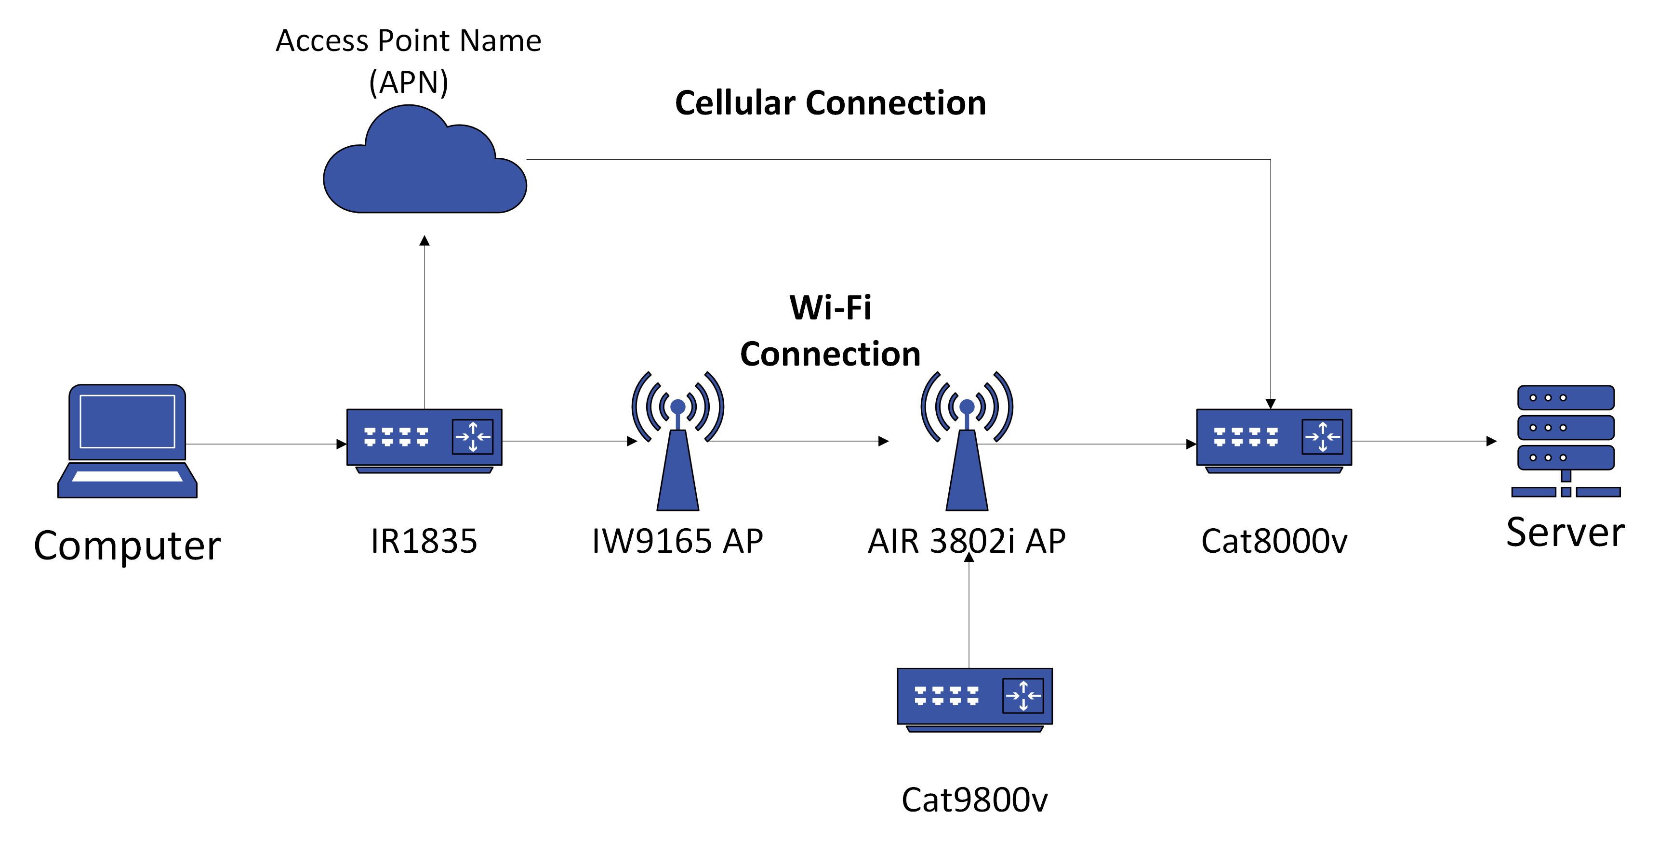
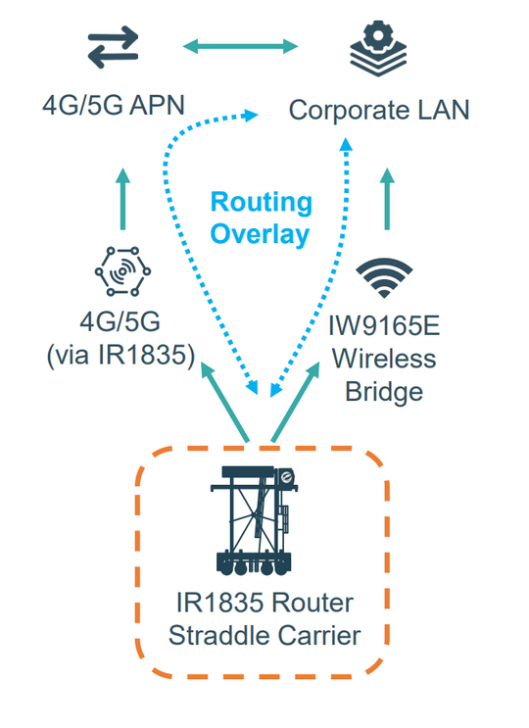

Achievement
a. system approach
Define the overlay connection that leverages dual connectivity of private 5G and ultra-fast Wi-Fi roaming for data transmission
Build the identical connection framework in the ICC facility lab to validate the resilience of multi-pathway connections from end-to-end devices.
Notes:
To tackle this challange, our collaboration define a system approach that define overlay connection that leverage dual connectivy via private 5G and ultra fast wifi roaming for data transmission, the first pathway connection on the left is cellular connection that implemented through 4G LTE or 5G technology that transmit the data from straddle carier into corporate LAN and its data centre, this transmission was ahieved by utilising cisco industrial router IR1835 that position directly into the straddle carrier as edge devices. by utilising the IR1835 we also able to establish Wi-Fi connection via the Industrial Wireless 9165 that connected directly with IR1835, the Industrial wireless is used to bridge the connetion via Wi-Fi transmission directly into the data centre that located in Corporate LAN. we then mimic. we then validated this design by replicating the same connection at the actual site in our own lab here at ICC. where we tested the system's feasibility and aiming to proof that this concept approach is achieveable.

Slide 6
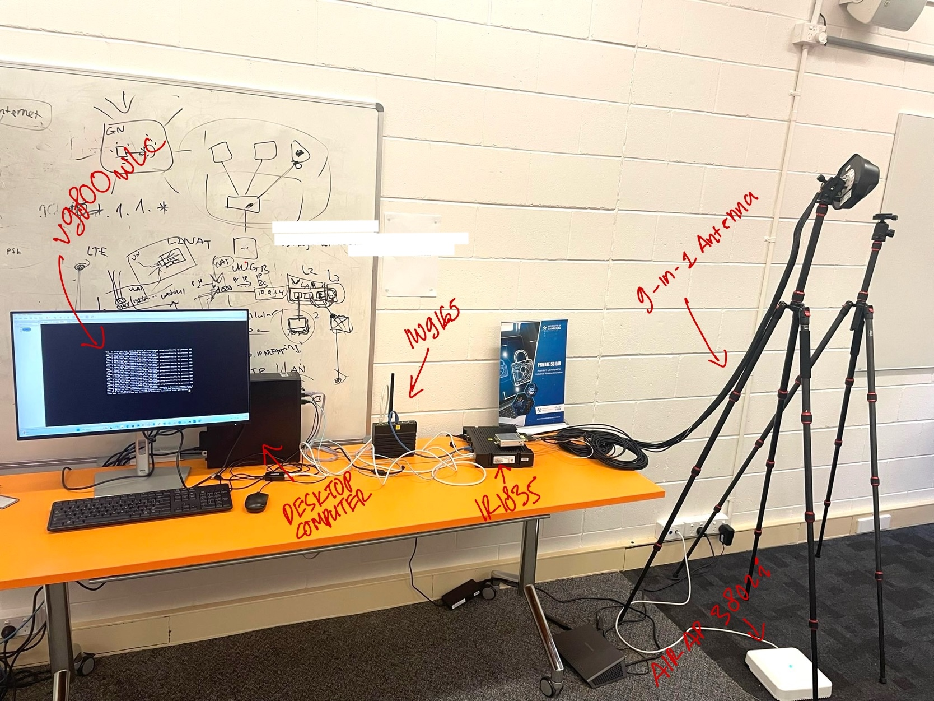
Achievement
a. system approach
Lab Implementation
Notes:
As you can see, in this image I have managed to build the system according to the privious diagram. There to pathaway of connection to transmit data, the cellular connection will directly reach outside network from the 5G modem that attached to the 9 in 1 antenna which then reach the access point name of the cellular provider, in this testbed we use Public Telstra cellular provider and its SIM card that istalled directly into the 5G modem since the private 5G is in progress. And for the Wi-Fi transmission connected our IW9165 access point directly with the router this then bridge via Wi-Fi transmission into the light weight cisco AP that trasmise the connection to the cloud service that host our cat800v and dummy server as data centre replicate.

Slide 7
Achievement
b. Task Undertaken
literature review
Initial Configuration
* Local Deployment
- Cisco AIR AP 3802i – Z – K9
- Cisco IR1835 Router
- Cisco IW9165
- Desktop Computer
- Virtual 9800 Wireless LAN controller
- Putty
* Cloud Deployment
- Azure Cloud
- Cisco Catalyst 8000v
- Ubuntu Linux
Testing
Documenting
Notes:
To achieve the testbed lab from the previous image, there are taks that outline the details and neccessary steps that are required to established the whole connection

Slide 8
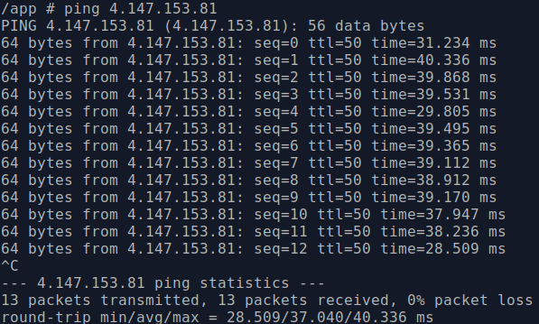
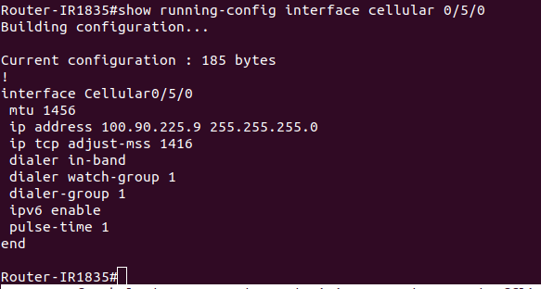
Achievement
C. Result
The network Connection via the cellular interface 0/5/0 with the P5GS6-GL modem and Telstra
APN is properly established, indicating that data can be transferred to the server via the Cellular
pathway.
ICMP Testing
Ensuring that cellular has received and IP address
Notes:
As a result, if the connection is configured properly the cellular interface will receive an IP address from the access point name of telstra mobile provider, we then conduct an initial testing by sendng an ICMP packet from the router to the server in Azure cloud. as you can see in the right image the data trasnmission is properly established indicated by 0 packet lost throughout the transmission.

Slide 9
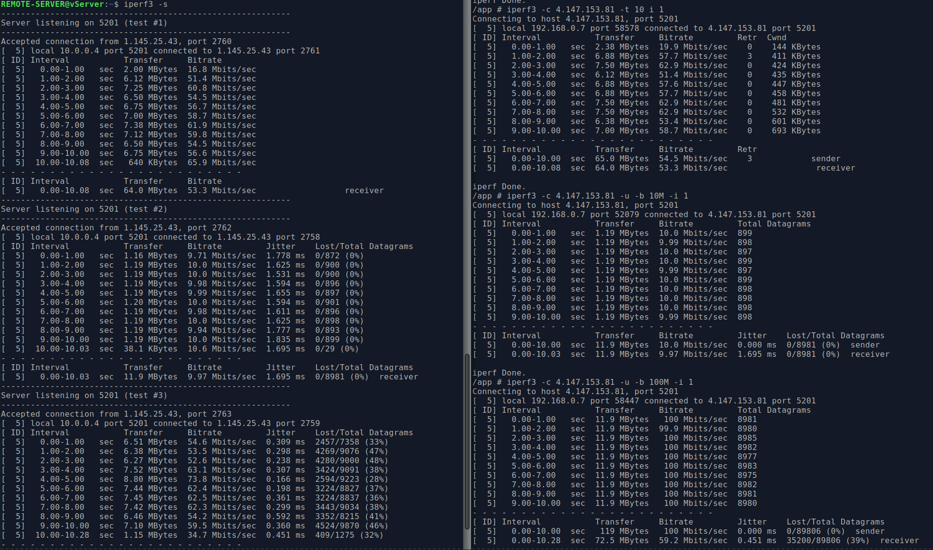
C. Result
TCP and UDP Testing

Slide 10
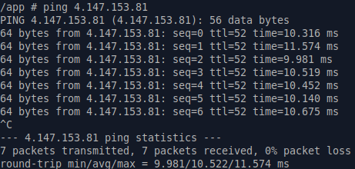
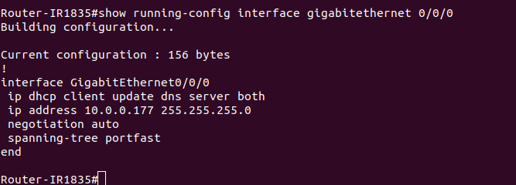
Achievement
C. Result
The network Connection via the Gigabit interface 0/0/0 with Cisco Catalyst IW9165 that bridges
traffic via Wi-Fi transference to AIR AP 3802i.
ICMP Testing
Ensuring that gigabit interface has received and IP address
Notes:
I also perform similar testing to ensure that the Wi-Fi pathway in connected properly, to ensure this I check the interface gigabitethernet 0/0/0 in which connected directly to the cinsco AP IW9165.

Slide 11
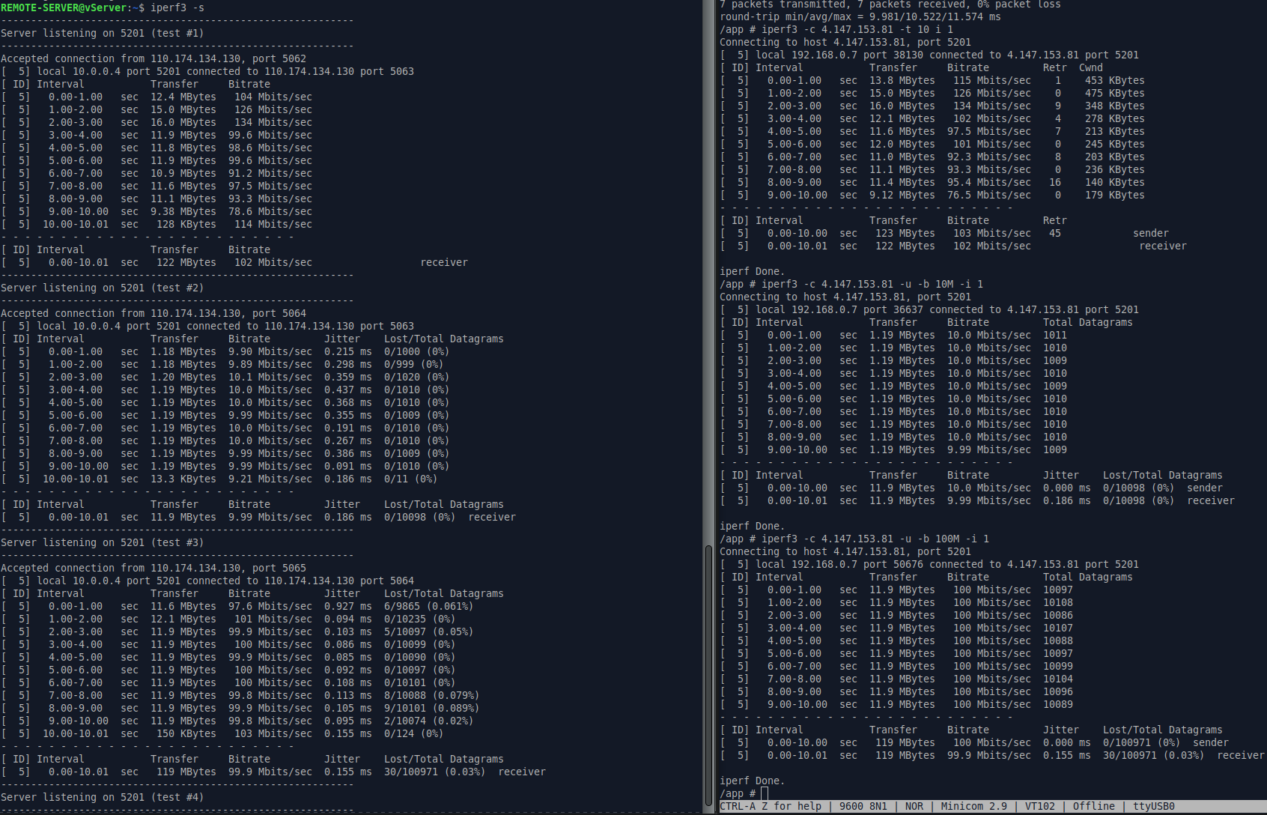
C. Result
TCP and UDP Testing

Slide 12
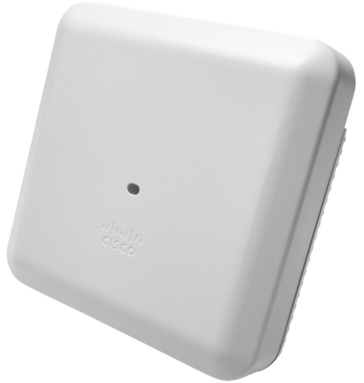
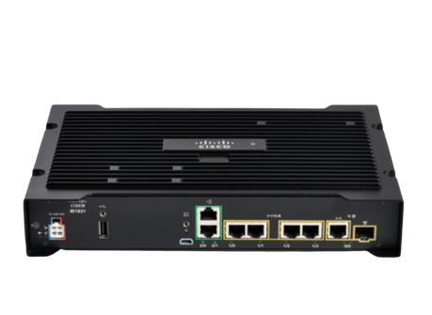
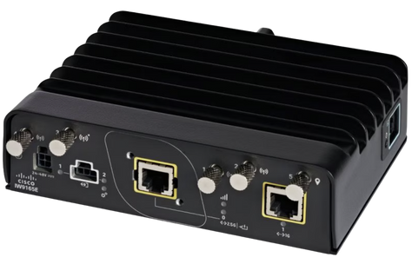
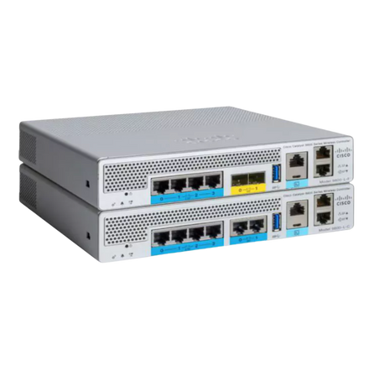
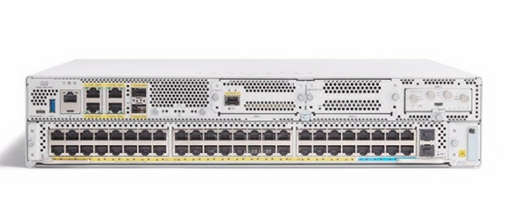
Achievement
d. Key Hardware
Cisco IR1835 is a router used as an edge computing device designed for CAN-bus data extraction, featuring a built-in 4G/5G/WiFi modem for multiple networks.
Cisco IW9165 serves as the access point to bridge traffic from the IR1835 router to the lightweight Cisco AP.
Cisco AIR 3802i - Z - K9 as the parent access point for incoming traffic from the bridge IW9165.
Cisco Catalyst 8000v provides secure and scalable connectivity via SD-WAN, offering multi-integration options.
Cisco Catalyst virtual Wireless LAN controller 9800 is used to control Cisco AIR 3802i

Slide 13
Achievement
d. Learning Outcome
Professional application of knowledge.
Professional skill development.
- Project management tools (Kanban via Azure DevOps, SharePoint, Google Drive)
- Technical skills with Cisco hardware
Networking and Mentorship
Workplace culture and expectation
Career exploration and refinement
Increase self-confidence
Enhance Employability
Reflection and self-awareness
Project management skills
Technical skill development

Slide 14





IMPACT
The network transformation will address the business need for fast and secure operations
This validation can be used for further research in critical infrastructure and to assist with the automation process in the recent competitive market.
Once validated, it can be further expanded to more sites for use in its facilities.
Which results in a profitable business for our industrial partner

Slide 15

Thank You

